Slide 1

CS 61C: Great Ideas in Computer Architecture Lecture 18: Amdahl’s Law and Data-Level Parallelism
Instructor: Sagar Karandikar
sagark@eecs.berkeley.edu
http://inst.eecs.berkeley.edu/~cs61c

Slide 2
Review
Performance
Bandwidth, measured in tasks/second
Latency, time to complete one task
“Iron Law” of computer performance:
Secs/program = insts/program * clocks/inst * secs/clock
IEEE-754 Floating-Point Standard
Sign-magnitude significand* 2 ^ biased exponent
Special values, NaN, Infinity, Denormals

Slide 3


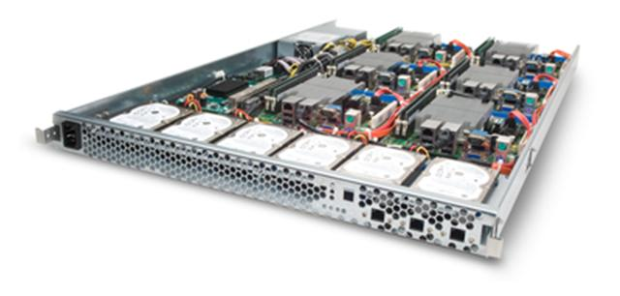
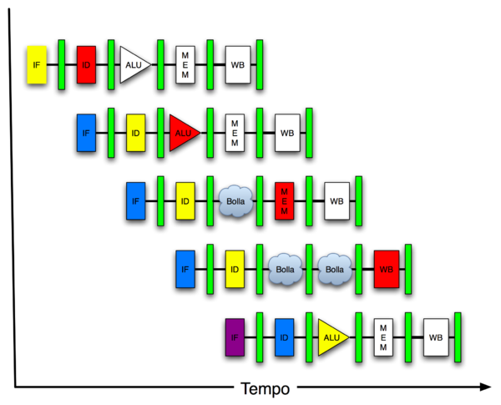
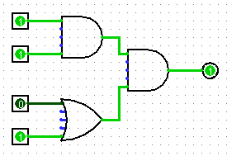
New-School Machine Structures (It’s a bit more complicated!)
Software Hardware
Parallel Requests
Assigned to computer
e.g., Search “Katz”
Parallel Threads
Assigned to core
e.g., Lookup, Ads
Parallel Instructions
>1 instruction @ one time
e.g., 5 pipelined instructions
Parallel Data
>1 data item @ one time
e.g., Add of 4 pairs of words
Hardware descriptions
All gates @ one time
Programming Languages
Warehouse Scale Computer
Smart Phone
Harness Parallelism &
Achieve High Performance
Computer
Core
…
Core
Memory (Cache)
Input/Output
Core
Today’s
Lecture
Instruction Unit(s)
Functional
Unit(s)
A₀+B₀
A₁+B₁
A₂+B₂
A₃+B₃
Cache Memory
Logic Gates

Slide 4
Using Parallelism for Performance
Two basic ways:
Multiprogramming
run multiple independent programs in parallel
“Easy”
Parallel computing
run one program faster
“Hard”
We’ll focus on parallel computing for next few lectures

Slide 5
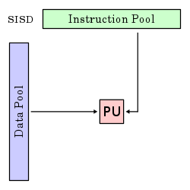
Single-Instruction/Single-Data Stream (SISD)
Sequential computer that exploits no parallelism in either the instruction or data streams. Examples of SISD architecture are traditional uniprocessor machines
Processing Unit

Slide 6
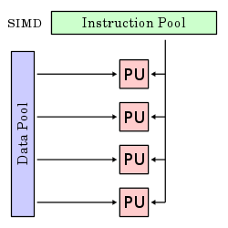
Single-Instruction/Multiple-Data Stream (SIMD or “sim-dee”)
SIMD computer exploits multiple data streams against a single instruction stream to operations that may be naturally parallelized, e.g., Intel SIMD instruction extensions or NVIDIA Graphics Processing Unit (GPU)

Slide 7
Multiple-Instruction/Multiple-Data Streams (MIMD or “mim-dee”)
Multiple autonomous processors simultaneously executing different instructions on different data.
MIMD architectures include multicore and Warehouse-Scale Computers
Instruction Pool
PU
PU
Data Pool
PU
PU

Slide 8
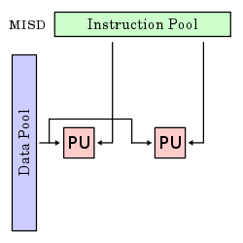
Multiple-Instruction/Single-Data Stream (MISD)
Multiple-Instruction, Single-Data stream computer that exploits multiple instruction streams against a single data stream.
Rare, mainly of historical interest only

Slide 9
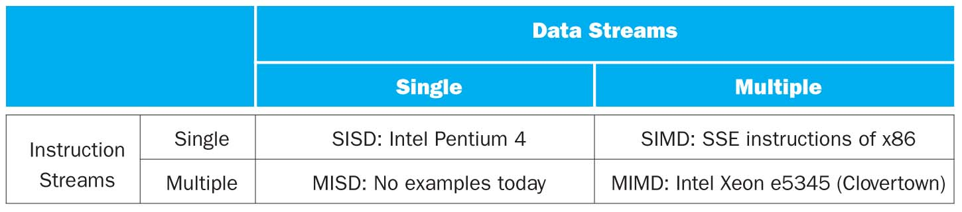

Flynn* Taxonomy, 1966
In 2013, SIMD and MIMD most common parallelism in architectures – usually both in same system!
Most common parallel processing programming style: Single Program Multiple Data (“SPMD”)
Single program that runs on all processors of a MIMD
Cross-processor execution coordination using synchronization primitives
SIMD (aka hw-level data parallelism): specialized function units, for handling lock-step calculations involving arrays
Scientific computing, signal processing, multimedia (audio/video processing)
*Prof. Michael Flynn, Stanford

Slide 10
Big Idea: Amdahl’s (Heartbreaking) Law
Speedup due to enhancement E is
Exec time w/o E
Speedup w/ E = ----------------------
Exec time w/ E
Suppose that enhancement E accelerates a fraction F (F <1) of the task by a factor S (S>1) and the remainder of the task is unaffected
Execution Time w/o E × [ (1-F) + F/S]
Execution Time w/ E =
1 / [ (1-F) + F/S ]
Speedup w/ E =

Slide 11
Big Idea: Amdahl’s Law
Speedup =
Example: the execution time of half of the program can be accelerated by a factor of 2. What is the program speed-up overall?

Slide 12
Big Idea: Amdahl’s Law
Speedup = 1
Example: the execution time of half of the program can be accelerated by a factor of 2. What is the program speed-up overall?
(1 - F) + F
Non-speed-up part
S
Speed-up part
1
1
=
=
1.33
0.5 + 0.5
0.5 + 0.25
2

Slide 13
Example #1: Amdahl’s Law
Speedup w/ E = 1 / [ (1-F) + F/S ]
Consider an enhancement which runs 20 times faster but which is only usable 25% of the time
Speedup w/ E = 1/(.75 + .25/20) = 1.31
What if its usable only 15% of the time?
Speedup w/ E = 1/(.85 + .15/20) = 1.17
Amdahl’s Law tells us that to achieve linear speedup with 100 processors, none of the original computation can be scalar!
To get a speedup of 90 from 100 processors, the percentage of the original program that could be scalar would have to be 0.1% or less
Speedup w/ E = 1/(.001 + .999/100) = 90.99

Slide 14
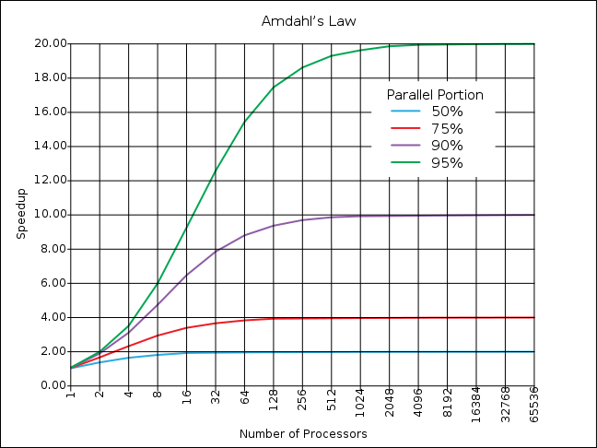
If the portion of the program that can be parallelized is small, then the speedup is limited
The non-parallel portion limits the performance

Slide 15
Strong and Weak Scaling
To get good speedup on a parallel processor while keeping the problem size fixed is harder than getting good speedup by increasing the size of the problem.
Strong scaling: when speedup can be achieved on a parallel processor without increasing the size of the problem
Weak scaling: when speedup is achieved on a parallel processor by increasing the size of the problem proportionally to the increase in the number of processors
Load balancing is another important factor: every processor doing same amount of work
Just one unit with twice the load of others cuts speedup almost in half
Notes:
Add load balancing example here – page 638

Slide 16
Clickers/Peer Instruction
Suppose a program spends 80% of its time in a square root routine. How much must you speedup square root to make the program run 5 times faster?
A: 5
B: 16
C: 20
D: 100
E: None of the above
Speedup w/ E = 1 / [ (1-F) + F/S ]
Notes:
VertLeftWhiteCheck1
Answer: 4th
Need infinitely fast to get to 5X
5 = 2.8
10 = 3.6
20 = 4.2
100 = 4.8

Slide 17
Administrivia
Project 3-1 Out
Last week, we built a CPU together, this week, you start building your own!
HW4 Out - Caches
Guerrilla Section on Pipelining, Caches on Thursday, 5-7pm, Woz

Slide 18
Administrivia
Midterm 2 is next Tuesday
In this room, at this time
Two double-sided 8.5”x11” handwritten cheatsheets
We’ll provide a MIPS green sheet
No electronics
Covers up to and including 07/21 lecture
Review session is Friday, 7/24 from 1-4pm in HP Aud.

Slide 19
Break

Slide 20
SIMD Architectures
Data parallelism: executing same operation on multiple data streams
Example to provide context:
Multiplying a coefficient vector by a data vector (e.g., in filtering)
y[i] := c[i] × x[i], 0 ≤ i < n
Sources of performance improvement:
One instruction is fetched & decoded for entire operation
Multiplications are known to be independent
Pipelining/concurrency in memory access as well

Slide 21
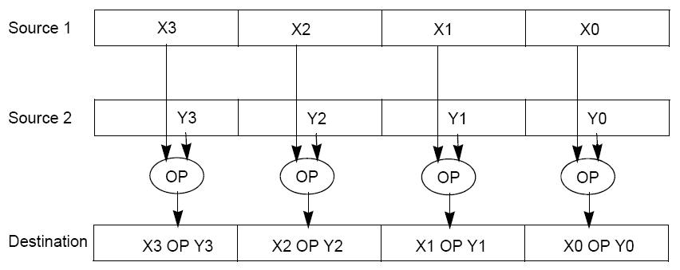
Intel “Advanced Digital Media Boost”
To improve performance, Intel’s SIMD instructions
Fetch one instruction, do the work of multiple instructions

Slide 22
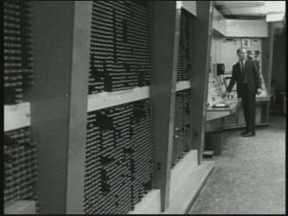
First SIMD Extensions: MIT Lincoln Labs TX-2, 1957

Slide 23
Intel SIMD Extensions
MMX 64-bit registers, reusing floating-point registers [1992]
SSE2/3/4, new 128-bit registers [1999]
AVX, new 256-bit registers [2011]
Space for expansion to 1024-bit registers

Slide 24
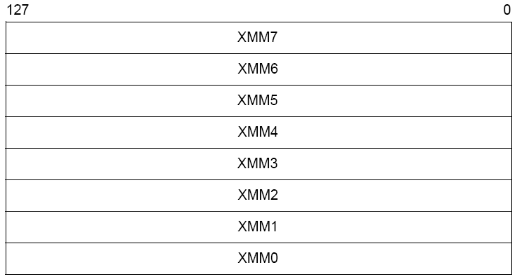
XMM Registers
Architecture extended with eight 128-bit data registers: XMM registers
x86 64-bit address architecture adds 8 additional registers (XMM8 – XMM15)

Slide 25
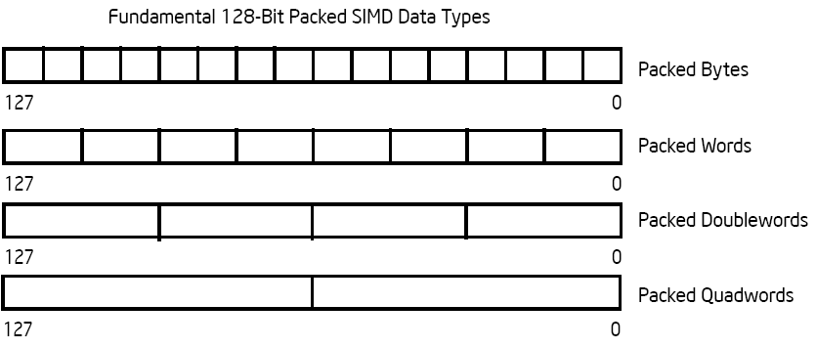
Intel Architecture SSE2+ 128-Bit SIMD Data Types
Note: in Intel Architecture (unlike MIPS) a word is 16 bits
Single-precision FP: Double word (32 bits)
Double-precision FP: Quad word (64 bits)
122 121
96 95
80 79
64 63
48 47
32 31
16 15
16 / 128 bits
122 121
96 95
80 79
64 63
48 47
32 31
16 15
8 / 128 bits
96 95
64 63
32 31
4 / 128 bits
64 63
2 / 128 bits

Slide 26
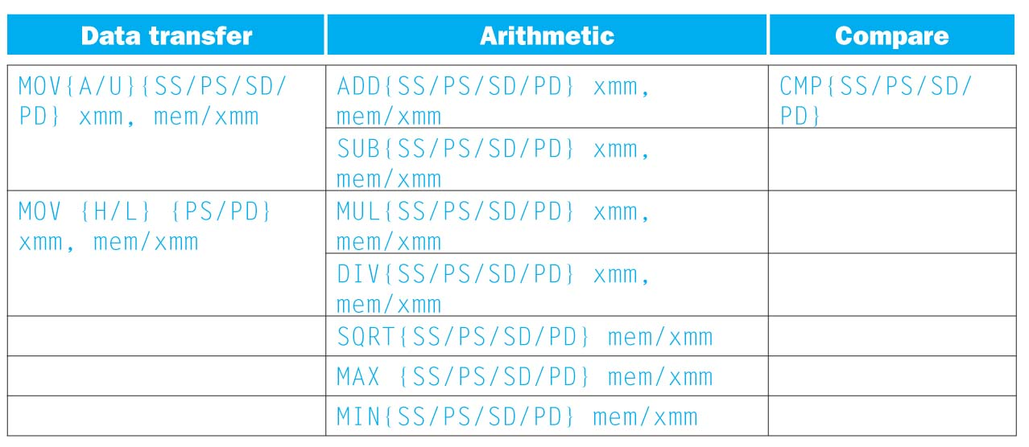
SSE/SSE2 Floating Point Instructions
Move does both load and store
xmm: one operand is a 128-bit SSE2 register
mem/xmm: other operand is in memory or an SSE2 register
{SS} Scalar Single precision FP: one 32-bit operand in a 128-bit register
{PS} Packed Single precision FP: four 32-bit operands in a 128-bit register
{SD} Scalar Double precision FP: one 64-bit operand in a 128-bit register
{PD} Packed Double precision FP, or two 64-bit operands in a 128-bit register
{A} 128-bit operand is aligned in memory
{U} means the 128-bit operand is unaligned in memory
{H} means move the high half of the 128-bit operand
{L} means move the low half of the 128-bit operand

Slide 27
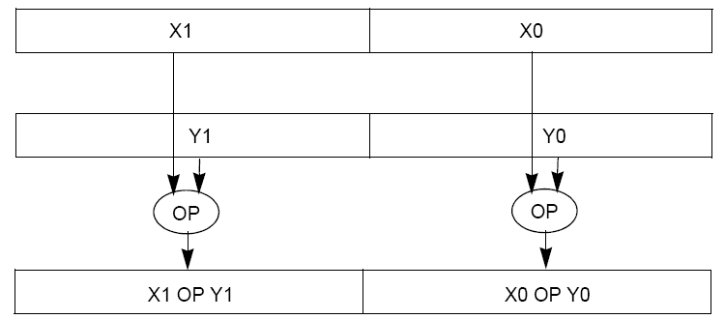
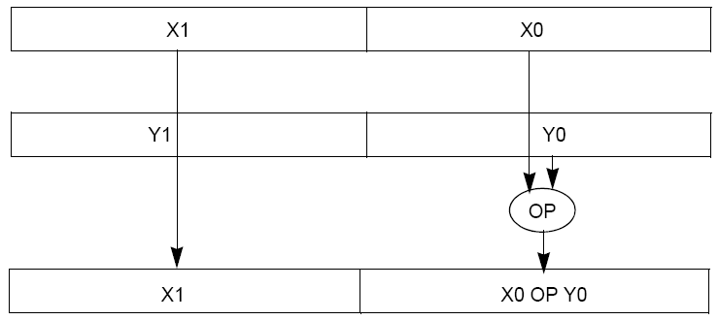
Packed and Scalar Double-Precision Floating-Point Operations
Packed
Scalar

Slide 28
Example: SIMD Array Processing
for each f in array
f = sqrt(f)
for each f in array
{
load f to the floating-point register
calculate the square root
write the result from the register to memory
}
for each 4 members in array
{
load 4 members to the SSE register
calculate 4 square roots in one operation
store the 4 results from the register to memory
}
SIMD style

Slide 29
Data-Level Parallelism and SIMD
SIMD wants adjacent values in memory that can be operated in parallel
Usually specified in programs as loops
for(i=1000; i>0; i=i-1)
x[i] = x[i] + s;
How can reveal more data-level parallelism than available in a single iteration of a loop?
Unroll loop and adjust iteration rate

Slide 30
Looping in MIPS
Assumptions:
$t1 is initially the address of the element in the array with the highest address
$f0 contains the scalar value s
8($t2) is the address of the last element to operate on
CODE:
Loop: 1. l.d $f2,0($t1) ; $f2=array element
2. add.d $f10,$f2,$f0 ; add s to $f2
3. s.d $f10,0($t1) ; store result
4. addui $t1,$t1,#-8 ; decrement pointer 8 byte
5. bne $t1,$t2,Loop ;repeat loop if $t1 != $t2

Slide 31
Loop Unrolled
Loop: l.d $f2,0($t1)
add.d $f10,$f2,$f0
s.d $f10,0($t1)
l.d $f4,-8($t1)
add.d $f12,$f4,$f0
s.d $f12,-8($t1)
l.d $f6,-16($t1)
add.d $f14,$f6,$f0
s.d $f14,-16($t1)
l.d $f8,-24($t1)
add.d $f16,$f8,$f0
s.d $f16,-24($t1)
addui $t1,$t1,#-32
bne $t1,$t2,Loop
NOTE:
Only 1 Loop Overhead every 4 iterations
This unrolling works if
loop_limit(mod 4) = 0
3. Using different registers for each iteration eliminates data hazards in pipeline

Slide 32
Loop Unrolled Scheduled
Loop:l.d $f2,0($t1)
l.d $f4,-8($t1)
l.d $f6,-16($t1)
l.d $f8,-24($t1)
add.d $f10,$f2,$f0
add.d $f12,$f4,$f0
add.d $f14,$f6,$f0
add.d $f16,$f8,$f0
s.d $f10,0($t1)
s.d $f12,-8($t1)
s.d $f14,-16($t1)
s.d $f16,-24($t1)
addui $t1,$t1,#-32
bne $t1,$t2,Loop
4 Loads side-by-side: Could replace with 4-wide SIMD Load
4 Adds side-by-side: Could replace with 4-wide SIMD Add
4 Stores side-by-side: Could replace with 4-wide SIMD Store

Slide 33
Loop Unrolling in C
Instead of compiler doing loop unrolling, could do it yourself in C
for(i=1000; i>0; i=i-1)
x[i] = x[i] + s;
Could be rewritten
for(i=1000; i>0; i=i-4) {
x[i] = x[i] + s;
x[i-1] = x[i-1] + s;
x[i-2] = x[i-2] + s;
x[i-3] = x[i-3] + s;
}
What is downside of doing it in C?

Slide 34
Generalizing Loop Unrolling
A loop of n iterations
k copies of the body of the loop
Assuming (n mod k) ≠ 0
Then we will run the loop with 1 copy of the body (n mod k) times and with k copies of the body floor(n/k) times

Slide 35
Example: Add Two Single-Precision Floating-Point Vectors
Computation to be performed:
vec_res.x = v1.x + v2.x;
vec_res.y = v1.y + v2.y;
vec_res.z = v1.z + v2.z;
vec_res.w = v1.w + v2.w;
SSE Instruction Sequence:
(Note: Destination on the right in x86 assembly)
movaps address-of-v1, %xmm0
// v1.w | v1.z | v1.y | v1.x -> xmm0
addps address-of-v2, %xmm0
// v1.w+v2.w | v1.z+v2.z | v1.y+v2.y | v1.x+v2.x -> xmm0
movaps %xmm0, address-of-vec_res
mov a ps : move from mem to XMM register, memory aligned, packed single precision
add ps : add from mem to XMM register, packed single precision
mov a ps : move from XMM register to mem, memory aligned, packed single precision

Slide 36
Break

Slide 37
Intel SSE Intrinsics
Intrinsics are C functions and procedures for inserting assembly language into C code, including SSE instructions
With intrinsics, can program using these instructions indirectly
One-to-one correspondence between SSE instructions and intrinsics

Slide 38
Example SSE Intrinsics
Instrinsics:
Corresponding SSE instructions:
Vector data type:
_m128d
Load and store operations:
_mm_load_pd MOVAPD/aligned, packed double
_mm_store_pd MOVAPD/aligned, packed double
_mm_loadu_pd MOVUPD/unaligned, packed double
_mm_storeu_pd MOVUPD/unaligned, packed double
Load and broadcast across vector
_mm_load1_pd MOVSD + shuffling/duplicating
Arithmetic:
_mm_add_pd ADDPD/add, packed double
_mm_mul_pd MULPD/multiple, packed double
Notes:
CS267 Lecture 2
38

Slide 39
Example: 2 x 2 Matrix Multiply
Definition of Matrix Multiply:
2
C_{i,j} = (A×B)_{i,j} = ∑ A_{i,k}× B_{k,j}
k = 1
A_{1,1}
A_{1,2}
B_{1,1}
B_{1,2}
C_{1,1}=A_{1,1}B_{1,1} + A_{1,2}B_{2,1}
C_{1,2}=A_{1,1}B_{1,2}+A_{1,2}B_{2,2}
x
=
A_{2,1}
A_{2,2}
B_{2,1}
B_{2,2}
C_{2,1}=A_{2,1}B_{1,1} + A_{2,2}B_{2,1}
C_{2,2}=A_{2,1}B_{1,2}+A_{2,2}B_{2,2}
1
0
1
3
C_{1,1}= 1*1 + 0*2 = 1
C_{1,2}= 1*3 + 0*4 = 3
x
=
0
1
2
4
C_{2,1}= 0*1 + 1*2 = 2
C_{2,2}= 0*3 + 1*4 = 4

Slide 40
Example: 2 x 2 Matrix Multiply
Using the XMM registers
64-bit/double precision/two doubles per XMM reg
C₁
C_{1,1}
C_{2,1}
Stored in memory in Column order
C₂
C_{1,2}
C_{2,2}
A
A_{1,i}
A_{2,i}
B₁
B_{i,1}
B_{i,1}
C₁
C₂
B₂
B_{i,2}
B_{i,2}

Slide 41
Example: 2 x 2 Matrix Multiply
Initialization
I = 1
C₁
0
0
C₂
0
0
A
A_{1,1}
A_{2,1}
_mm_load_pd: Stored in memory in Column order
B₁
B_{1,1}
B_{1,1}
_mm_load1_pd: SSE instruction that loads a double word and stores it in the high and low double words of the XMM register
B₂
B_{1,2}
B_{1,2}

Slide 42
Example: 2 x 2 Matrix Multiply
Initialization
I = 1
C₁
0
0
C₂
0
0
A
A_{1,1}
A_{2,1}
_mm_load_pd: Load 2 doubles into XMM reg, Stored in memory in Column order
B₁
B_{1,1}
B_{1,1}
_mm_load1_pd: SSE instruction that loads a double word and stores it in the high and low double words of the XMM register (duplicates value in both halves of XMM)
B₂
B_{1,2}
B_{1,2}

Slide 43
Example: 2 x 2 Matrix Multiply
First iteration intermediate result
I = 1
C₁
0+A_{1,1}B_{1,1}
0+A_{2,1}B_{1,1}
c1 = _mm_add_pd(c1,_mm_mul_pd(a,b1));
c2 = _mm_add_pd(c2,_mm_mul_pd(a,b2));
SSE instructions first do parallel multiplies and then parallel adds in XMM registers
C₂
0+A_{1,1}B_{1,2}
0+A_{2,1}B_{1,2}
A
A_{1,1}
A_{2,1}
_mm_load_pd: Stored in memory in Column order
B₁
B_{1,1}
B_{1,1}
_mm_load1_pd: SSE instruction that loads a double word and stores it in the high and low double words of the XMM register (duplicates value in both halves of XMM)
B₂
B_{1,2}
B_{1,2}

Slide 44
Example: 2 x 2 Matrix Multiply
First iteration intermediate result
I = 2
C₁
0+A_{1,1}B_{1,1}
0+A_{2,1}B_{1,1}
c1 = _mm_add_pd(c1,_mm_mul_pd(a,b1));
c2 = _mm_add_pd(c2,_mm_mul_pd(a,b2));
SSE instructions first do parallel multiplies and then parallel adds in XMM registers
C₂
0+A_{1,1}B_{1,2}
0+A_{2,1}B_{1,2}
A
A_{1,2}
A_{2,2}
_mm_load_pd: Stored in memory in Column order
B₁
B_{2,1}
B_{2,1}
_mm_load1_pd: SSE instruction that loads a double word and stores it in the high and low double words of the XMM register (duplicates value in both halves of XMM)
B₂
B_{2,2}
B_{2,2}

Slide 45
Example: 2 x 2 Matrix Multiply
Second iteration intermediate result
I = 2
C_{1,1}
C_{2,1}
C₁
A_{1,1}B_{1,1}+A_{1,2}B_{2,1}
A_{2,1}B_{1,1}+A_{2,2}B_{2,1}
c1 = _mm_add_pd(c1,_mm_mul_pd(a,b1));
c2 = _mm_add_pd(c2,_mm_mul_pd(a,b2));
SSE instructions first do parallel multiplies and then parallel adds in XMM registers
C₂
A_{1,1}B_{1,2}+A_{1,2}B_{2,2}
A_{2,1}B_{1,2}+A_{2,2}B_{2,2}
C_{1,2}
C_{2,2}
A
A_{1,2}
A_{2,2}
_mm_load_pd: Stored in memory in Column order
B₁
B_{2,1}
B_{2,1}
_mm_load1_pd: SSE instruction that loads a double word and stores it in the high and low double words of the XMM register (duplicates value in both halves of XMM)
B₂
B_{2,2}
B_{2,2}

Slide 46
Example: 2 x 2 Matrix Multiply
Definition of Matrix Multiply:
2
C_{i,j} = (A×B)_{i,j} = ∑ A_{i,k}× B_{k,j}
k = 1
A_{1,1}
A_{1,2}
B_{1,1}
B_{1,2}
C_{1,1}=A_{1,1}B_{1,1} + A_{1,2}B_{2,1}
C_{1,2}=A_{1,1}B_{1,2}+A_{1,2}B_{2,2}
x
=
A_{2,1}
A_{2,2}
B_{2,1}
B_{2,2}
C_{2,1}=A_{2,1}B_{1,1} + A_{2,2}B_{2,1}
C_{2,2}=A_{2,1}B_{1,2}+A_{2,2}B_{2,2}
1
0
1
3
C_{1,1}= 1*1 + 0*2 = 1
C_{1,2}= 1*3 + 0*4 = 3
x
=
0
1
2
4
C_{2,1}= 0*1 + 1*2 = 2
C_{2,2}= 0*3 + 1*4 = 4

Slide 47
Example: 2 x 2 Matrix Multiply (Part 1 of 2)
#include <stdio.h>
// header file for SSE compiler intrinsics
#include <emmintrin.h>
// NOTE: vector registers will be represented in comments as v1 = [ a | b]
// where v1 is a variable of type __m128d and a, b are doubles
int main(void) {
// allocate A,B,C aligned on 16-byte boundaries
double A[4] __attribute__ ((aligned (16)));
double B[4] __attribute__ ((aligned (16)));
double C[4] __attribute__ ((aligned (16)));
int lda = 2;
int i = 0;
// declare several 128-bit vector variables
__m128d c1,c2,a,b1,b2;
// Initialize A, B, C for example
/* A = (note column order!)
1 0
0 1
*/
A[0] = 1.0; A[1] = 0.0; A[2] = 0.0; A[3] = 1.0;
/* B = (note column order!)
1 3
2 4
*/
B[0] = 1.0; B[1] = 2.0; B[2] = 3.0; B[3] = 4.0;
/* C = (note column order!)
0 0
0 0
*/
C[0] = 0.0; C[1] = 0.0; C[2] = 0.0; C[3] = 0.0;

Slide 48
Example: 2 x 2 Matrix Multiply (Part 2 of 2)
// used aligned loads to set
// c1 = [c_11 | c_21]
c1 = _mm_load_pd(C+0*lda);
// c2 = [c_12 | c_22]
c2 = _mm_load_pd(C+1*lda);
for (i = 0; i < 2; i++) {
/* a =
i = 0: [a_11 | a_21]
i = 1: [a_12 | a_22]
*/
a = _mm_load_pd(A+i*lda);
/* b1 =
i = 0: [b_11 | b_11]
i = 1: [b_21 | b_21]
*/
b1 = _mm_load1_pd(B+i+0*lda);
/* b2 =
i = 0: [b_12 | b_12]
i = 1: [b_22 | b_22]
*/
b2 = _mm_load1_pd(B+i+1*lda);
/* c1 =
i = 0: [c_11 + a_11*b_11 | c_21 + a_21*b_11]
i = 1: [c_11 + a_21*b_21 | c_21 + a_22*b_21]
*/
c1 = _mm_add_pd(c1,_mm_mul_pd(a,b1));
/* c2 =
i = 0: [c_12 + a_11*b_12 | c_22 + a_21*b_12]
i = 1: [c_12 + a_21*b_22 | c_22 + a_22*b_22]
*/
c2 = _mm_add_pd(c2,_mm_mul_pd(a,b2));
}
// store c1,c2 back into C for completion
_mm_store_pd(C+0*lda,c1);
_mm_store_pd(C+1*lda,c2);
// print C
printf("%g,%g\n%g,%g\n",C[0],C[2],C[1],C[3]);
return 0;
}

Slide 49
Inner loop from gcc –O -S
L2: movapd (%rax,%rsi), %xmm1 //Load aligned A[i,i+1]->m1
movddup (%rdx), %xmm0 //Load B[j], duplicate->m0
mulpd %xmm1, %xmm0 //Multiply m0*m1->m0
addpd %xmm0, %xmm3 //Add m0+m3->m3
movddup 16(%rdx), %xmm0 //Load B[j+1], duplicate->m0
mulpd %xmm0, %xmm1 //Multiply m0*m1->m1
addpd %xmm1, %xmm2 //Add m1+m2->m2
addq $16, %rax // rax+16 -> rax (i+=2)
addq $8, %rdx // rdx+8 -> rdx (j+=1)
cmpq $32, %rax // rax == 32?
jne L2 // jump to L2 if not equal
movapd %xmm3, (%rcx) //store aligned m3 into C[k,k+1]
movapd %xmm2, (%rdi) //store aligned m2 into C[l,l+1]

Slide 50
And in Conclusion, …
Amdahl’s Law: Serial sections limit speedup
Flynn Taxonomy
Intel SSE SIMD Instructions
Exploit data-level parallelism in loops
One instruction fetch that operates on multiple operands simultaneously
128-bit XMM registers
SSE Instructions in C
Embed the SSE machine instructions directly into C programs through use of intrinsics
Achieve efficiency beyond that of optimizing compiler

